Slide 1



GPU Programming with CUDA
CUDA编程模型
王桢
wangzh665@mail.sysu.edu.cn
中山大学 数据科学与计算机学院
国家超级计算广州中心

Slide 2
课程概要
计算机架构分类
CPU vs GPU
NVIDIA GPU架构
CUDA编程模型
CUDA编程举例

Slide 3
计算机架构分类
Flynn’s taxonomy
1972年由费林（Michael J. Flynn） 提出
根据指令和数据进入CPU的方式分类
SISD, SIMD, MISD, MIMD

Slide 4
计算机架构分类
Flynn’s taxonomy
SISD
经典冯诺依曼架构
PU：处理单元
SIMD
多个处理单元使用同样指令处理不同数据
早期向量超级计算机
70年代-90年代
向量处理器
GPU？There are differences!
现代CPU具有SIMD指令
如Intel MMX, SSE指令集等

Slide 5
计算机架构分类
Flynn’s taxonomy
MISD
严格说采取这种结构的计算机并未实现
近似：流水线架构
一条指令的执行被分为多个步骤
交给不同硬件处理单元
MIMD
多个处理单元使用不同指令处理不同数据
处理单元之间可完全独立
从2006年起，前10的超级计算机以及Top 500榜单上大多数超级计算机都采用此架构

Slide 6
课程概要
计算机架构分类
CPU vs GPU
NVIDIA GPU架构
CUDA编程模型
CUDA编程举例

Slide 7

CPU vs GPU
性能
延迟：一个操作从开始到完成所需的时间（ms）
带宽：单位时间内可处理的数据量（MB/s, GB/s）
吞吐量：单位时间内成功可处理的运算量（gflops）
CPU
目标：降低延迟
提高串行代码性能
更适用于复杂单任务
GPU
目标：提高吞吐量
大规模并行架构
更适用于大量相似任务

Slide 8
CPU vs GPU
CPU
大缓存
掩盖较长的存储器延迟
强大的运算器
降低运算延迟
复杂的控制机制
分支预测等
线程上下文切换开销大
降低一个或两个线程运行延迟
GPU
小缓存
但通过更快的存储提高吞吐量
更节能的运算器
延迟长但总吞吐量更大
简单的控制流机制
无分支预测
线程高度轻量级
大量并发
Notes:
Complex control mechanisms: CPUs have complex control mechanisms to manage instruction execution, handle interrupts, coordinate data flow, and manage resources efficiently. These mechanisms ensure that instructions are executed correctly and efficiently.
Branch prediction: CPUs use branch prediction mechanisms to anticipate the outcome of conditional branches in code. This helps in minimizing the performance impact of branch instructions by speculatively executing instructions based on predictions, which leads to improved performance by reducing stalls and keeping the pipeline filled with instructions, even if some of them end up being discarded later.
High overhead of thread context switches: Context switching between threads imposes overhead on the CPU, as it involves saving and restoring the state of the processor registers and other resources.
Reduced latency of one or two threads running: Despite the overhead of context switching, CPUs can still achieve low latency for one or two threads running concurrently. This is because modern CPUs are designed to efficiently execute instructions in parallel and handle multiple threads simultaneously, leveraging techniques like out-of-order execution and hyper-threading.
Traditionally, instructions are executed in the order they appear in the program. However, in out-of-order execution, the CPU dynamically reorders the execution of instructions to maximize the utilization of execution units and minimize idle time.
Here's how it works:
Instructions are fetched and decoded in order but are then dispatched to the execution units out of order, based on data availability and resource availability.
The CPU employs sophisticated hardware mechanisms, such as reservation stations and reorder buffers, to track dependencies between instructions and ensure correct program execution despite the out-of-order execution.
For example, if one instruction is waiting for the result of a previous instruction, the CPU can execute subsequent independent instructions in the meantime, improving overall throughput.
Out-of-order execution allows the CPU to make better use of its resources and reduce the impact of pipeline stalls, resulting in improved performance for many workloads.
Hyper-Threading, also known as simultaneous multithreading (SMT), is a technology developed by Intel that enables a single physical CPU core to appear as two logical cores to the operating system. Each logical core shares the resources of the physical core, such as execution units and cache, but maintains its own architectural state.
GPU 的运算单元通常更节能，因为它们更多地专注于数值计算而不是通用目的计算。

Slide 9
异构架构
CPU+GPU
利用CPU处理复杂控制流
利用GPU处理大规模运算
CPU与GPU之间通过PCIe总线通信
新显卡支持通过NVLink直接连接（提供5-12倍于PCIe 3.0总线带宽）
Notes:
PCIe Gen 3 operates at 8 GT/s (gigatransfers per second) which roughly translates to 1 GB/s per PCIe lane.

Slide 10
课程概要
计算机架构分类
CPU vs GPU
NVIDIA GPU架构
CUDA编程模型
CUDA编程举例

Slide 11
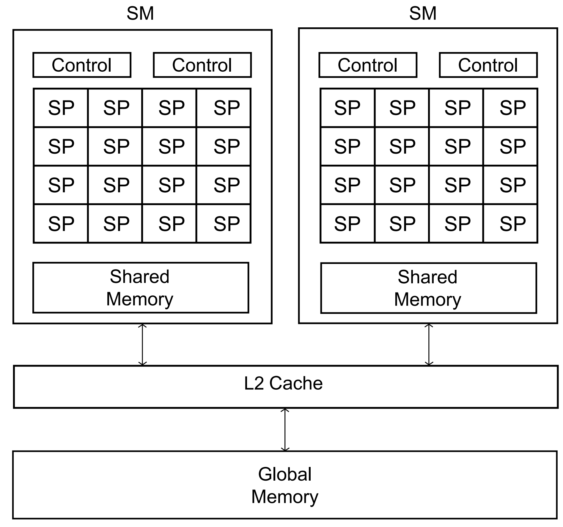
Block diagram of a GPU

Slide 12
SIMT vs SIMD
A typical GPU can be thought of as being composed of one or more SIMD processors.
Nvidia GPUs are composed of Streaming Multiprocessors or SMs
One SM have several control units and many more datapaths, i.e., consisting of SIMDs

Slide 13
SIMT vs SIMD
The “datapaths” are called Streaming Processors, or SPs
SIMT stands for Single Instruction Multiple Thread, and the term is used because threads on an SM that are executing the same instruction may not execute simultaneously
Each SM has a relatively small&quick block of memory that is shared among its SPs
All SMs on a single chip have access to a much larger&slow block of memory shared among all the SPs

Slide 14
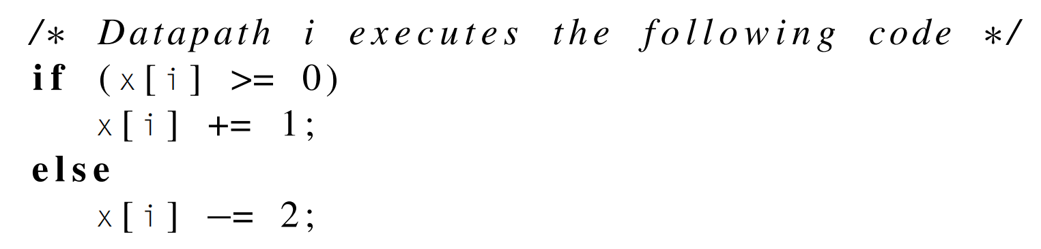
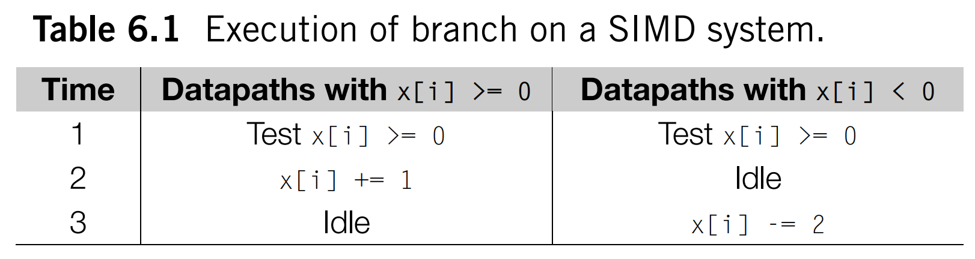
SIMT vs SIMD

Slide 15
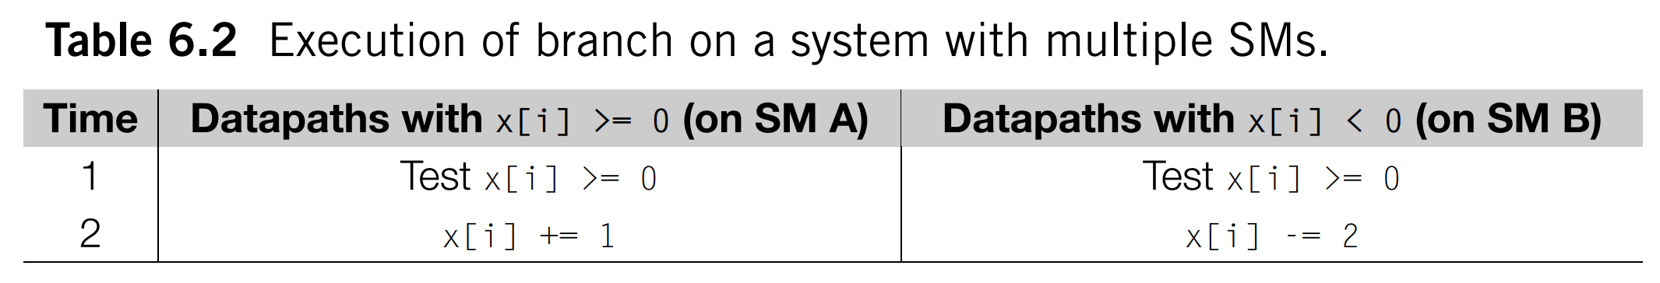
SIMT vs SIMD
The SMs operate asynchronously: there is no penalty if one branch of an if-else executes on one SM, and the other executes on another SM.

Slide 16
NVIDIA GPU架构
2级架构
每个GPU拥有多个Streaming Multiprocessor (SM)
具体数目及设计因产品而异
SM共用显存
每个SM拥有多个CUDA core
数目因产品而异
Core共用调度器和指令缓存
Notes:
共享调度器（Shared Scheduler）：在单个流多处理器中，有一个调度器（Scheduler）负责为所有 CUDA 核心分配指令以执行。这个调度器会从待执行的指令池中选择适当的指令，并将它们分配给空闲的 CUDA 核心。在共享调度器的情况下，所有 CUDA 核心都共享同一个调度器。这意味着所有核心都使用同一个调度器来决定下一个要执行的指令，而不是每个核心都有自己的独立调度器。
共享指令缓存（Shared Instruction Cache）：指令缓存存储了正在执行的指令，以便流多处理器可以快速访问它们。在单个流多处理器中，通常会有一个指令缓存，所有 CUDA 核心共享它。这意味着所有核心都使用相同的指令缓存来获取它们需要执行的指令，而不是每个核心都有自己的独立指令缓存。

Slide 17
NVIDIA GPU架构
2级架构下的执行模式：线程束（warp）
CUDA线程以32个为一组在GPU上执行
线程束以单指令多线程的方式运行（SIMT）
所有线程在不同数据上执行相同的指令
SIMT，SIMD，SMT (simultaneous multithreading)
灵活度：SIMD < SIMT <SMT
性能：SIMD > SIMT > SMT
SIMT与SIMD相比：多个状态寄存器，多个地址，独立的执行路径
http://yosefk.com/blog/simd-simt-smt-parallelism-in-nvidia-gpus.html
SM负责调度并执行线程束
线程束调度时会产生上下文切换
调度方式因架构而异
Notes:
SIMT emphasize the independence and flexibility of individual threads, each with its own set of state registers, memory addresses (Each thread in a SIMT architecture has its own unique thread context, including its own program counter and memory address space. Therefore, each thread can access different memory addresses independently of other threads.), and execution paths (Each thread in a SIMT architecture executes independently, following its own execution path through the program. Threads may diverge or converge based on conditional branches).
vs
SIMD architectures, on the other hand, focus on executing the same instruction on multiple data elements simultaneously, typically with fewer state registers and shared memory address space among processing elements.
The warp scheduler in the SM manages the order in which warps are executed and ensures that the SM remains fully utilized by keeping all execution units busy.
Instructions are fetched from the instruction cache and decoded. The decoded instructions are dispatched to the execution units within the SM. Each warp is assigned to an execution unit based on the type of instruction being executed. Instructions within a warp are executed in parallel, with the execution unit processing multiple threads' instructions simultaneously. Each instruction goes through several pipeline stages within the execution unit, including instruction fetch, decode, operand fetch, execute, and writeback. If threads within a warp take different execution paths (e.g., due to conditional branches), the SM executes both paths concurrently through a process called warp divergence. This involves disabling threads that are not taking the current execution path and stalling their execution until they can be synchronized with other threads in the warp.

Slide 18
NVIDIA GPU架构
Tegra
面向移动和嵌入式设备
平板电脑、手机等
GeForce
面向一般图形用户
家用电脑，优化游戏性能
Quadro
面向专业绘图设计需求
图形工作站，优化专业绘图软件性能
Tesla
面向大规模计算
没有显示输出
此前深度学习神器v100即属于此系列
更强大的双精度运算能力
更大的内存带宽

Slide 19
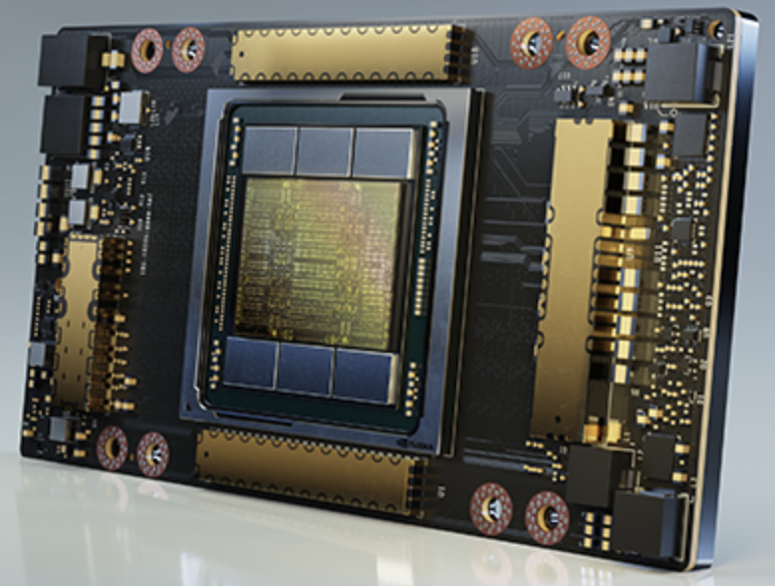
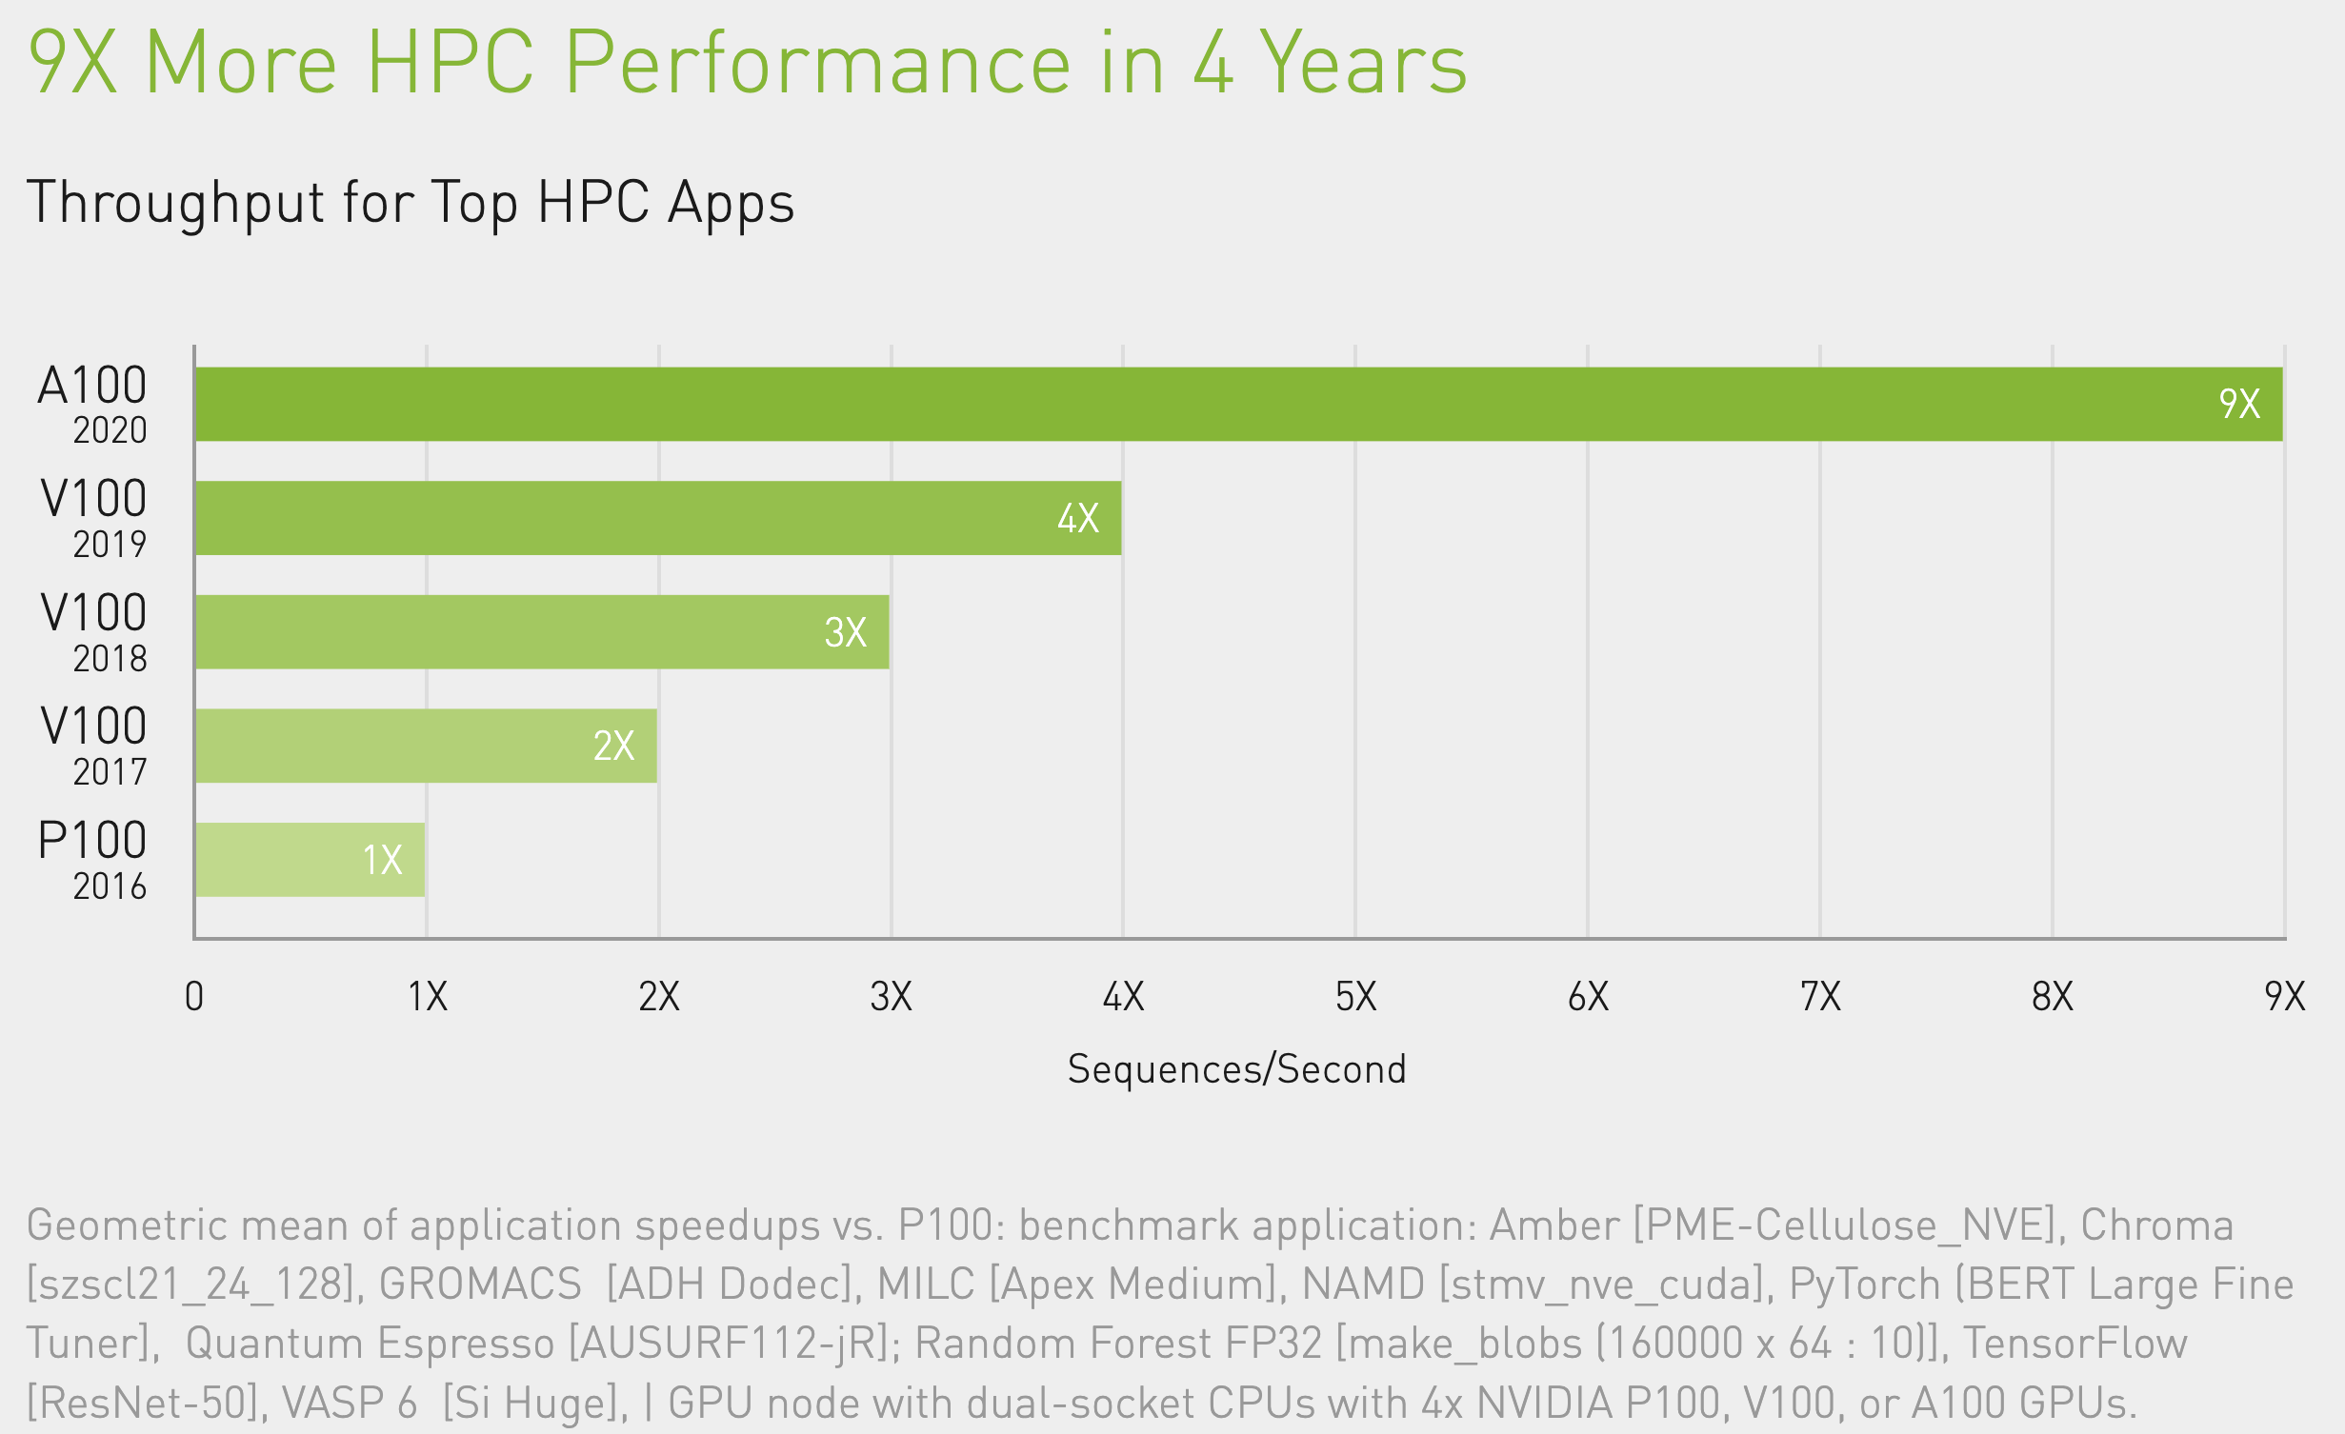
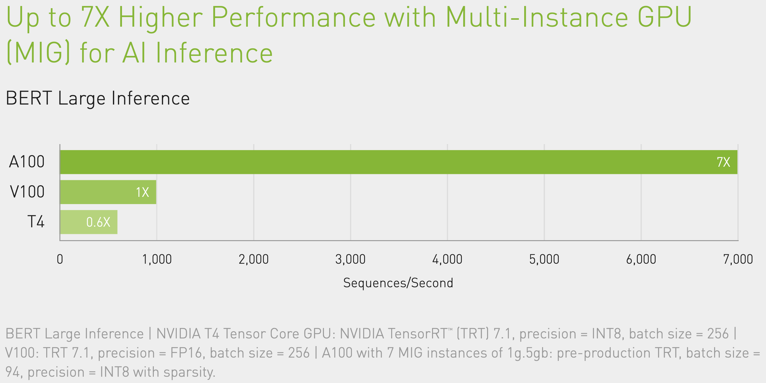
NVIDIA GPU架构
NVIDIA A100 Tensor Core GPU
“Engine of the NVIDIA data center platform”
“A100 can efficiently scale to thousands of GPUs”
“Multi-Instance GPU (MIG) technology allows multiple networks to operate simultaneously on a single A100 GPU for optimal utilization of compute resources.”
图片来自NVIDIA

Slide 20
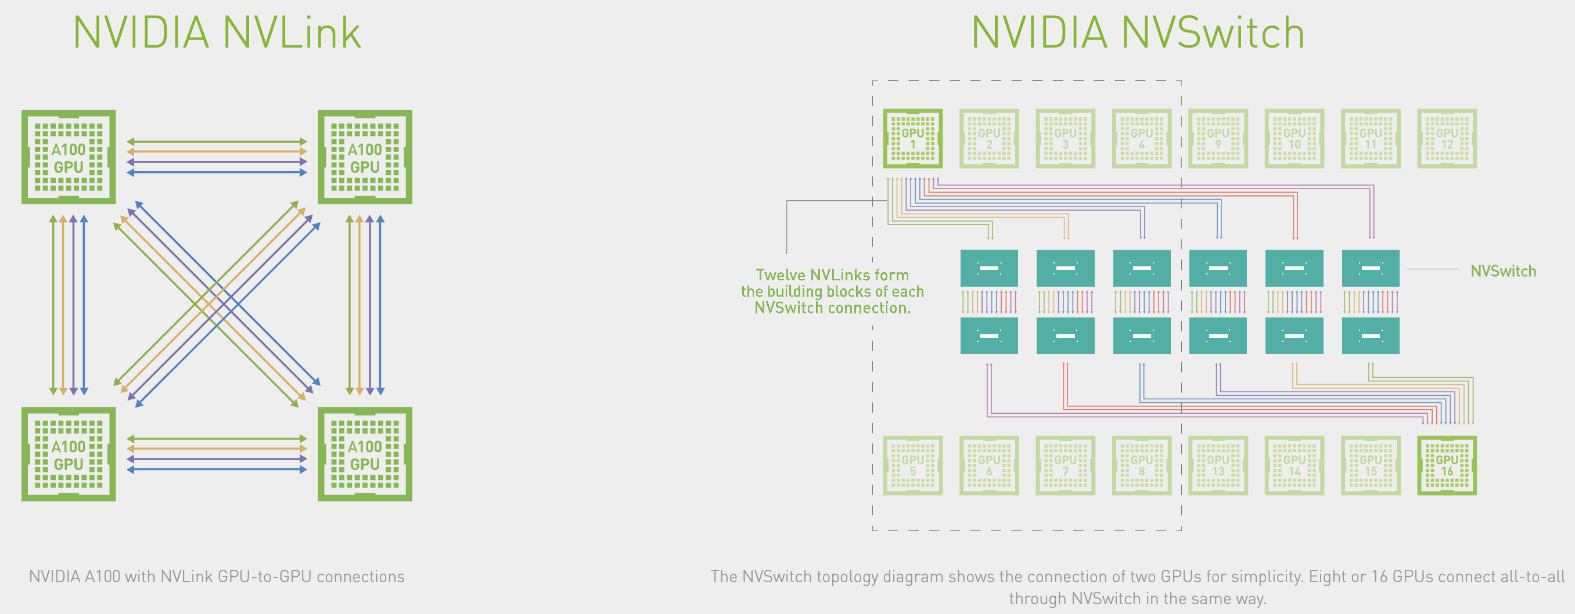
NVIDIA GPU架构
NVSwitch 与NVIDIA HGX A100
NVSwitch: NVLink组成的全连接架构
HGX A100: 在一张主板上由NVSwitch连接多张A100计算卡
4x/8x/16x-A100：人工智能也要进入军备竞赛阶段了
图片来自NVIDIA

Slide 21
NVIDIA GPU架构
Tesla (2006)→Fermi (2010)→Kepler (2012)→Maxwell (2014) →Pascal (2016)→Volta (2017)→Turing (2018)→Ampere(2020)
更新速度加快
CUDA核心数量及内存大小增加
峰值计算性能和内存带宽提高
 | “Kepler” K20 | “Kepler” K40 | “Maxwell” M40 | Pascal P100 | Volta V100
CUDA cores | 2496 | 2880 | 3072 | 3584 | 5120
Cores per SM | 192 | 192 | 128 | 64 | 64
Single Precision | 3.52 Tflops | 4.29 Tflops | 7.0 Tflops | 9.5 Tflops | 15 Tflops
Double Precision | 1.17 TFlops | 1.43 Tflops | 0.21 Tflops | 4.7 Tflops | 7.5Tflops
Memory Bandwidth | 208 GB/s | 288 GB/s | 288 GB/s | 720 GB/s | 900 GB/s
Memory | 5 GB | 12 GB | 12 GB | 12/16 GB | 16 GB

Slide 22
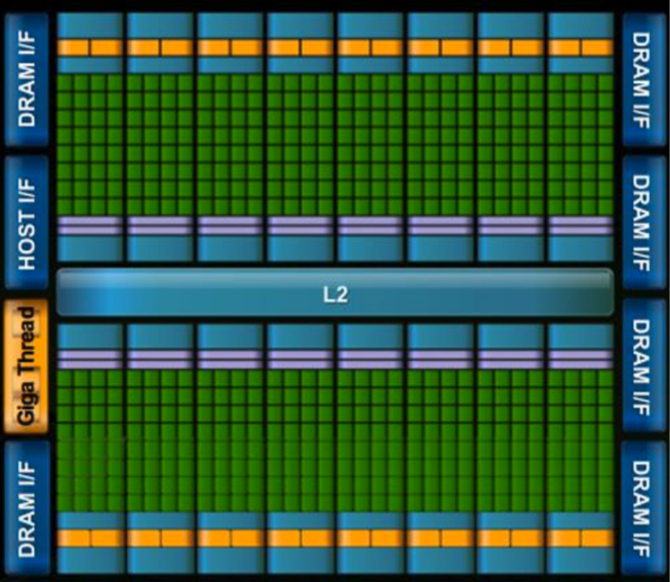
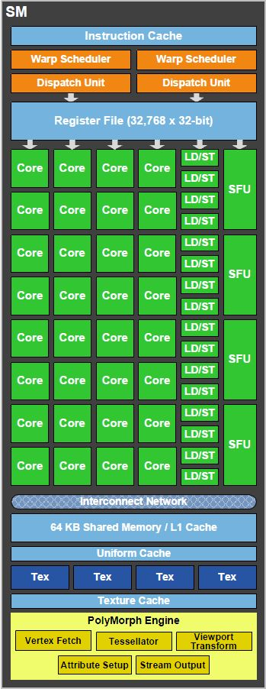
NVIDIA GPU架构
Fermi
芯片划分为多个SM
每个SM上32个CUDA core
无缓存一致性
SM之间没有通信
图片来自NVIDIA

Slide 23
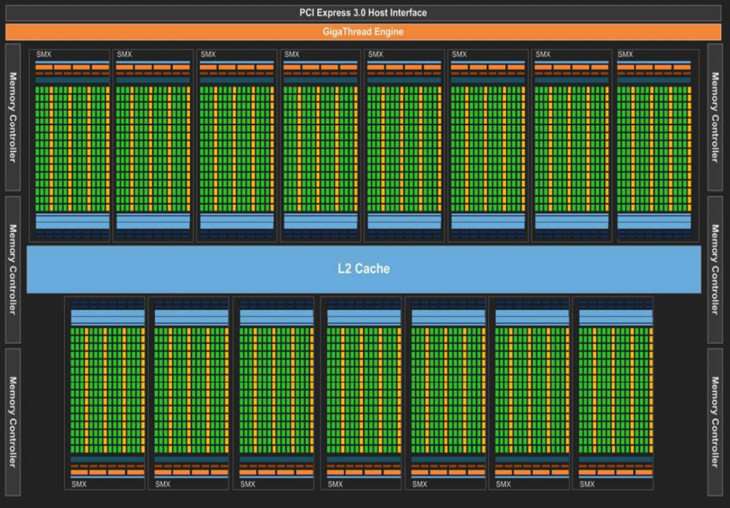
NVIDIA GPU架构
Kepler
芯片划分为多个SMX
Streaming Multiprocessor Extreme
SMX上core数目大大增加（192）
提供二级缓存一致性
图片来自NVIDIA

Slide 24
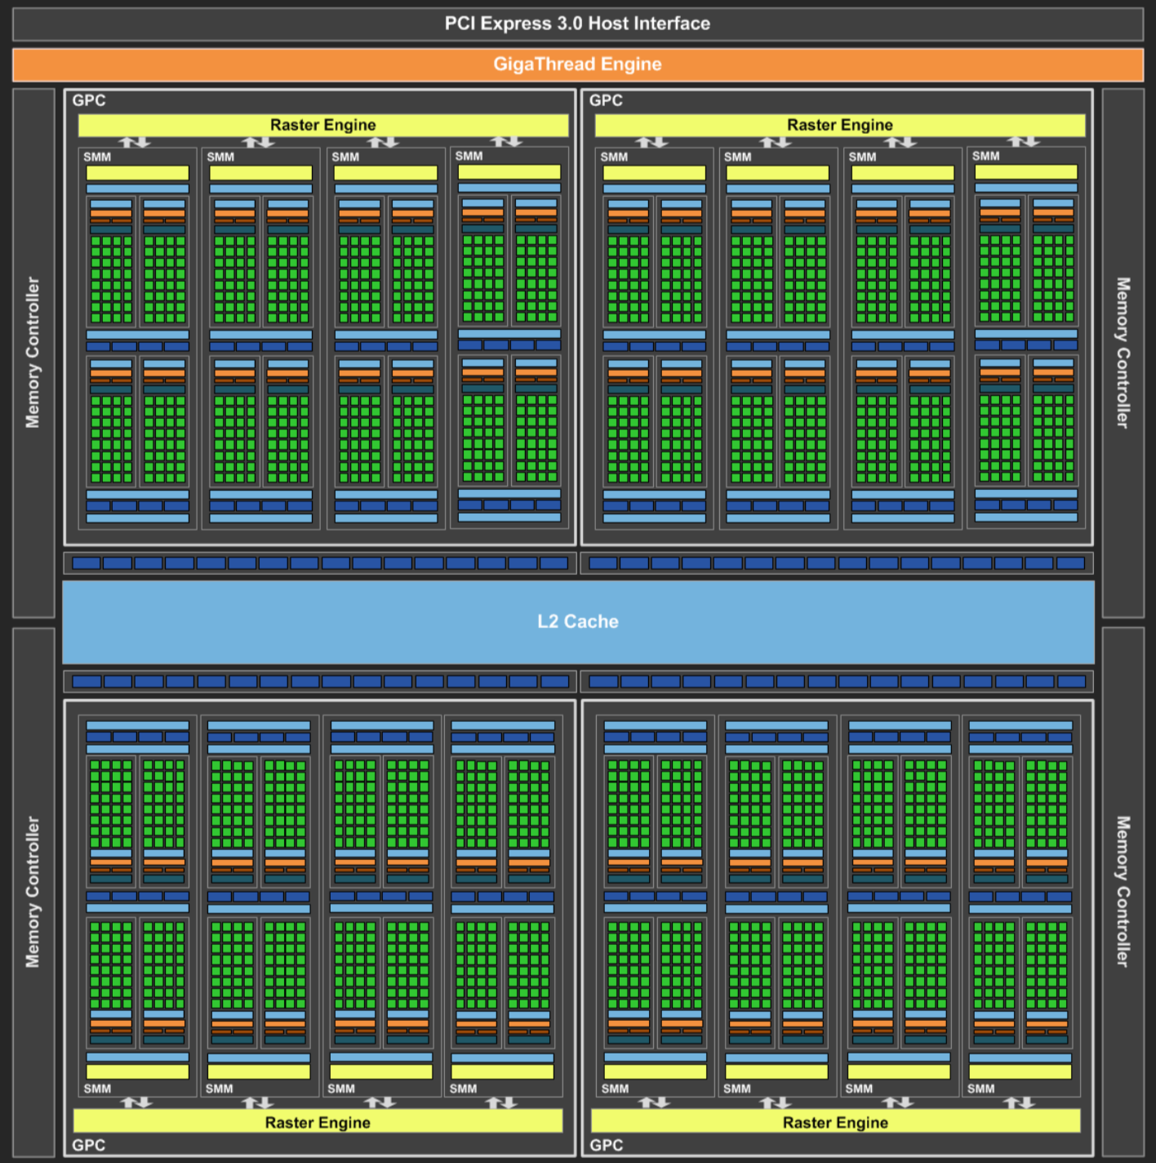
NVIDIA GPU架构
Maxwell
芯片划分为四个GPC（quadrant）
每个GPC上有多个Streaming Multiprocessor Module (SMM)
SMM减少了core数目但提高了能源效率
192→128
50%能耗
90%运算能力
图片来自NVIDIA

Slide 25
NVIDIA GPU架构
Pascal
更多GPC、SM、CUDA cores
支持NVLink
极大地增加带宽
图片来自NVIDIA

Slide 26
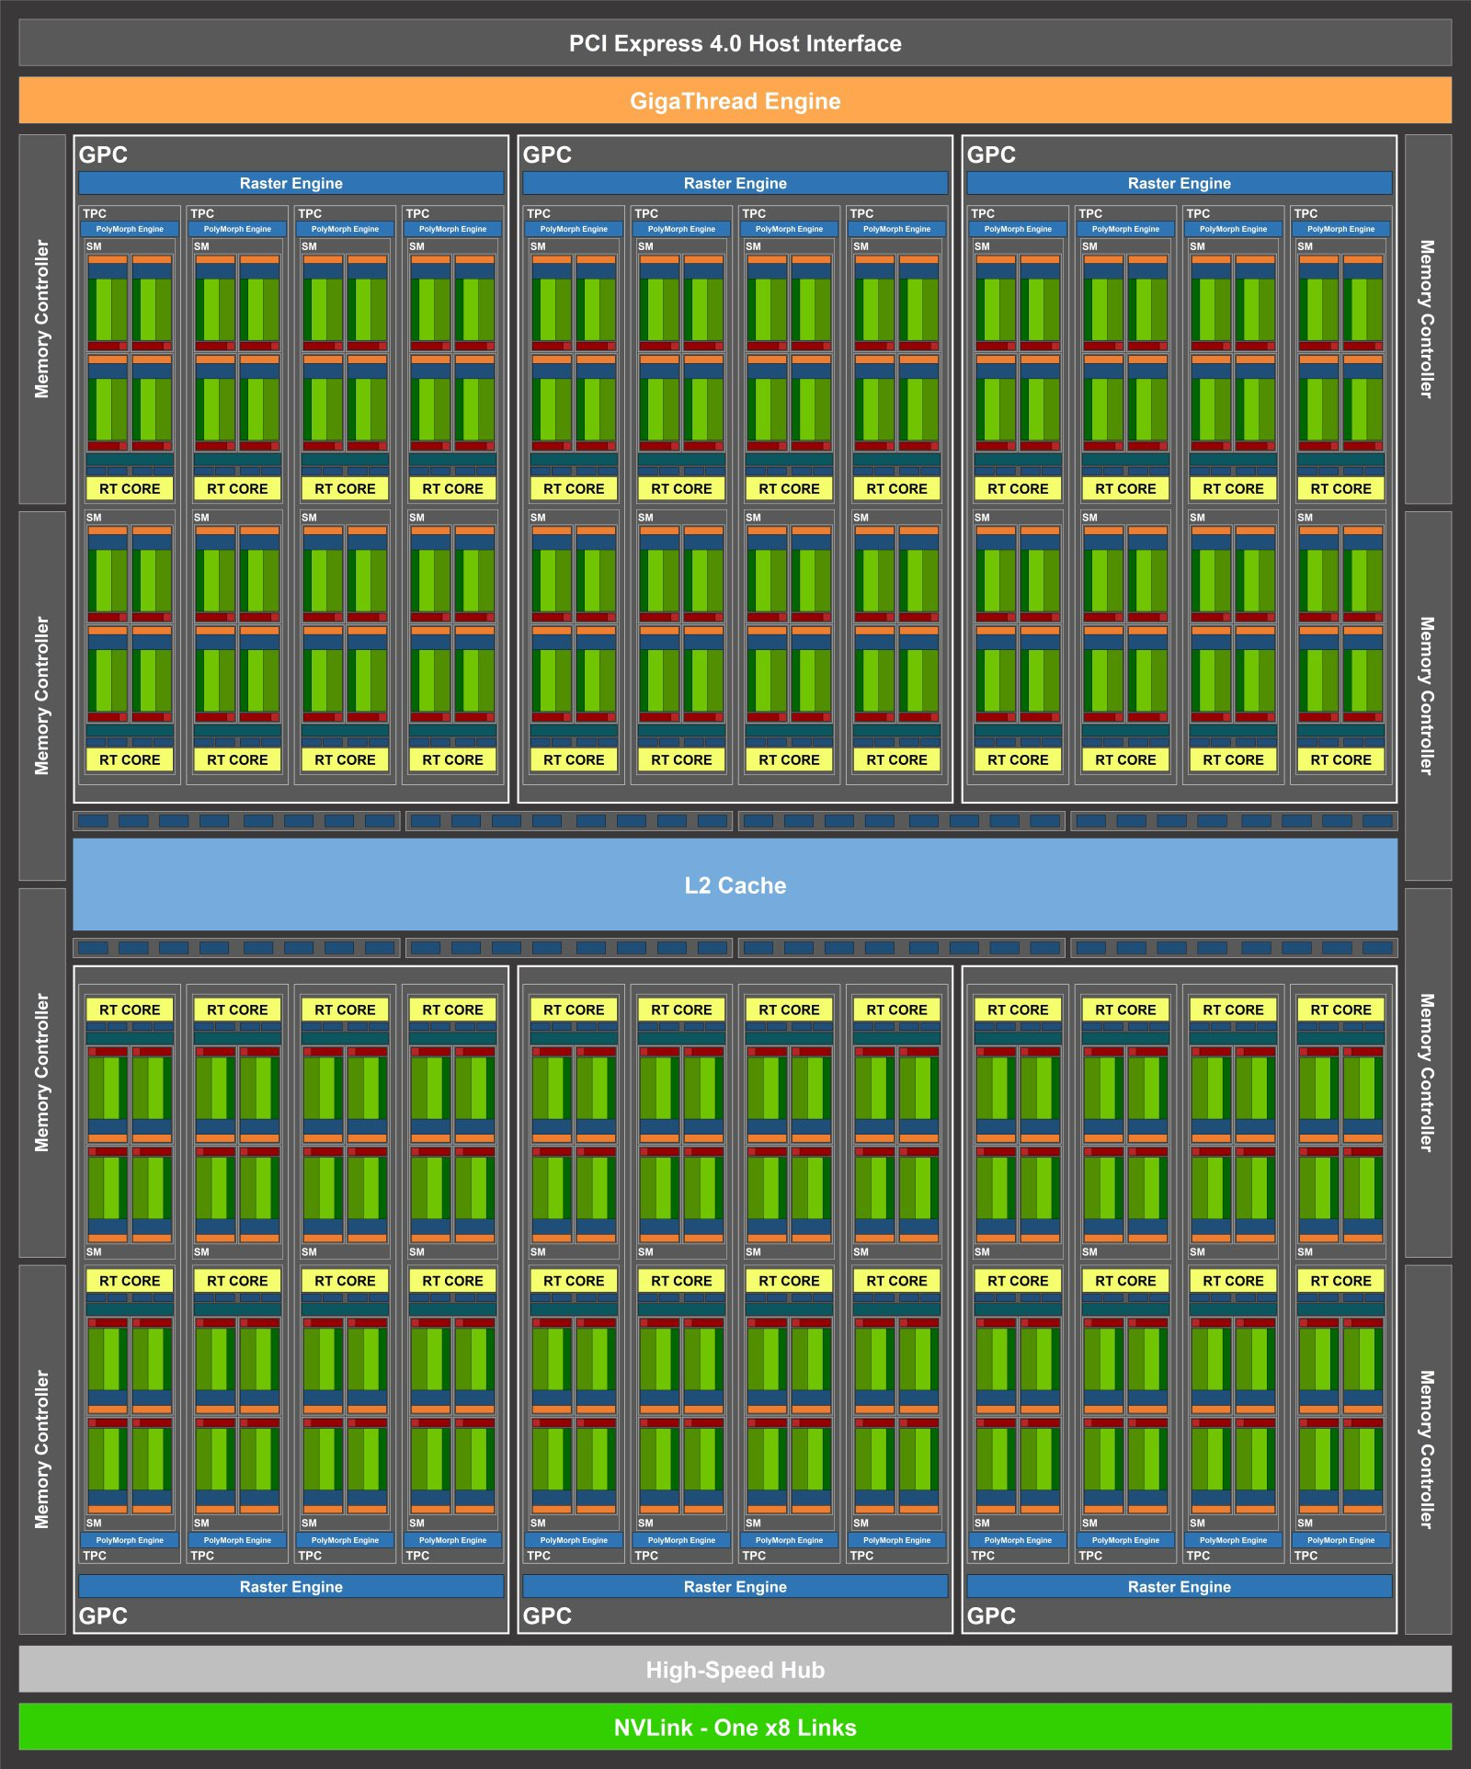
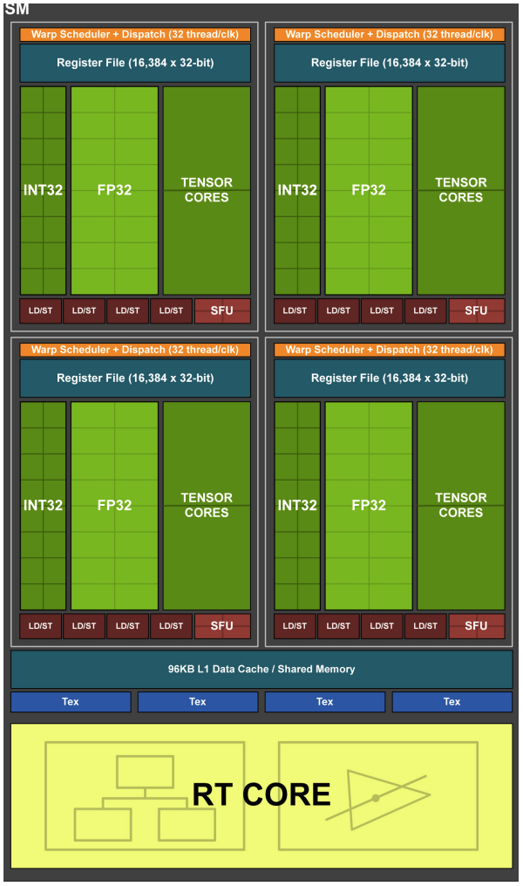
NVIDIA GPU架构
Turing & Ampere
右图为单个SM
增加Tensor cores
增加Ray Tracing cores
图片来自NVIDIA
Notes:
Tensor cores are specialized processing units found in NVIDIA GPUs that are designed specifically to accelerate tensor operations, which are fundamental to deep learning and artificial intelligence (AI) workloads.
Ray tracing cores designed specifically to accelerate ray tracing operations. Ray tracing is a rendering technique used in computer graphics to generate highly realistic images by simulating the way light interacts with objects in a scene.

Slide 27
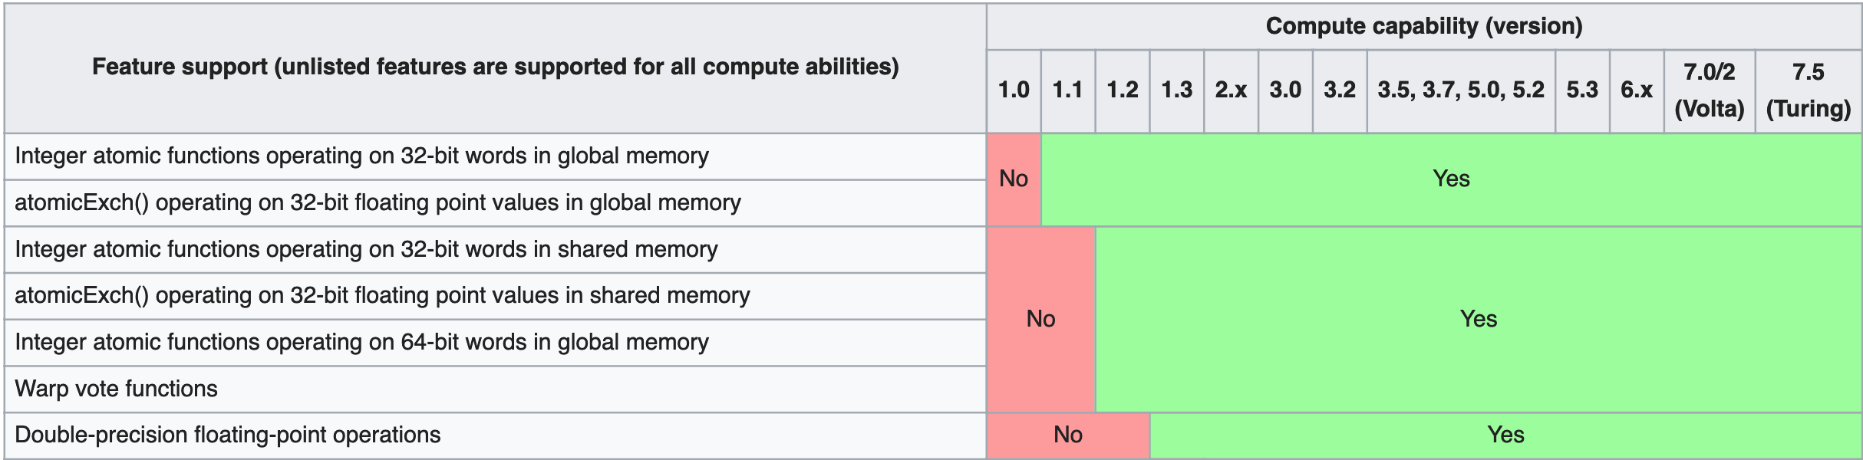
NVIDIA GPU架构
计算能力（compute capability）
不同架构的NVIDIA GPU拥有不同计算能力
由硬件决定，不同于CUDA版本
计算能力≠运算性能
参考https://en.wikipedia.org/wiki/CUDA
图片截取自https://en.wikipedia.org/wiki/CUDA

Slide 28
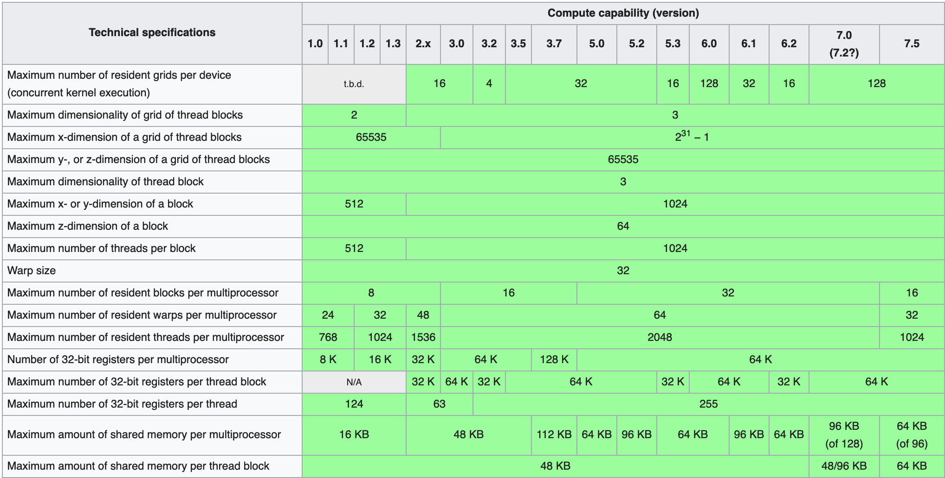
NVIDIA GPU架构
计算能力（compute capability）
图片截取自https://en.wikipedia.org/wiki/CUDA

Slide 29
NVIDIA GPU架构
CUDA的架构分类
异构
CPU+GPU
CPU执行host代码
GPU执行device代码
SIMD？
线程束以SIMD方式执行
SPMD？
SM之间拥有一定的独立性

Slide 30
课程概要
计算机架构分类
CPU vs GPU
NVIDIA GPU架构
CUDA编程模型
CUDA编程举例

Slide 31
CUDA编程模型
Host与device
Host(CPU相关）：运行在CPU上的代码及主机内存
Device（GPU相关）：运行在GPU上的代码及显存（设备内存）
通过在主机上调用核函数（kernel）执行并行代码
Notes:
kernel execution is asynchronous

Slide 32
CUDA编程模型
指明host与device代码
__host__ 从主机端调用，在主机端执行
__global__ 从主机端调用，在设备端执行
计算能力5.0后设备已经可以在设备端调用
__device__ 从设备端调用，在设备端执行
__host__与__device__限定符可以一起使用
函数可以从主机端和设备端调用
__global__ void hello_d(){
printf("Hello World from GPU!");
}
__host__ void hello_h(){
printf("Hello World from CPU!")
hello_d<<<1,4>>>();
cudaDeviceSynchronize();
}
输出：
Hello World from CPU!
Hello World from GPU!
Hello World from GPU!
Hello World from GPU!
Hello World from GPU!

Slide 33
CUDA编程模型
指明host与device代码
<<<1,4>>>为执行配置
指明网格中有1个块
每块中有4个线程
cudaDeviceSynchronize();
与OpenMP不同，CUDA核函数为异步执行
调用完成后，控制权立即返回给CPU
__global__ void hello_d(){
printf("Hello World from GPU!");
}
__host__ void hello_h(){
printf("Hello World from CPU!")
hello_d<<<1,4>>>();
cudaDeviceSynchronize();
}
输出：
Hello World from CPU!
Hello World from GPU!
Hello World from GPU!
Hello World from GPU!
Hello World from GPU!

Slide 34
CUDA编程模型
指明host与device代码
核函数限制条件（__global__函数）
只能访问设备内存
必须返回void
不支持可变数量的参数
int func_name(int n_args, ...)
参数不可为引用类型
不支持静态变量
Notes:
... in the function declaration indicates that the function can accept a variable number of arguments after the fixed arguments.
Inside the function definition, va_list, va_start, va_arg, and va_end macros from the <cstdarg> header are used to process the variable arguments.

Slide 35
CUDA编程模型
执行配置
指明网格及块的维度
形式为<<< grid, block >>>
网格与块均可为1维、2维、或3维
Notes:
Specify the number of blocks and the number of threads in each block
Each block consists of a specified number of threads that run on the same SM

Slide 36
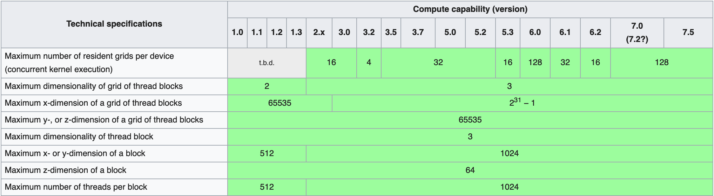
CUDA编程模型
执行配置
指明网格及块的维度
形式为<<< grid, block>>>
grid与block为dim3类型（三个分量为x, y, z)
grid与block的大小受到计算能力的限制
图片截取自https://en.wikipedia.org/wiki/CUDA
Notes:
All of these structs have three fields, x, y, and z, and the fields all have unsigned
integer types.

Slide 37
CUDA编程模型
GPU架构与线程组织
Notes:
CUDA requires that thread blocks be independent. So one thread block must be able to complete its execution, regardless of the states of the other thread blocks

Slide 38
CUDA编程模型
确定线程编号
使用内置变量threadIdx, blockIdx, blockDim

Slide 39
CUDA编程模型
确定线程编号
使用内置变量threadIdx, blockIdx, blockDim
dim3类型
只可用于设备代码上
__global__ void hello_d(){
int bid = blockIdx.x;
int tid = threadIdx.x;
printf(“Hello World from thread (%d, %d)”, bid, tid);
}
__host__void hello_h(){
hello_d<<<2,4>>>();
cudaDeviceSynchronize();
}

Slide 40
课程概要
计算机架构分类
CPU vs GPU
NVIDIA GPU架构
CUDA编程模型
CUDA编程举例

Slide 41
CUDA编程举例
向量相加
已知长度为n的两个向量a与b，求向量c，使c[i]=a[i]+b[i]
数据依赖性：非循环迭代相关
串行代码（循环）
void vector_add(int *a, int* b, int* c, int n){
for(int i = 0; i < n; ++i) {
c[i] = a[i] + b[i];
}
}

Slide 42
CUDA编程举例
例：向量相加
已知长度为n的两个向量a与b，求向量c，使c[i]=a[i]+b[i]
串行代码（循环）
CUDA（使用1个block）
void vector_add(int *a, int* b, int* c, int n){
for(int i = 0; i < n; ++i) {
c[i] = a[i] + b[i];
}
}
__global__ void vector_add(int *a, int* b, int* c){
int tid = threadIdx.x;
c[tid] = a[tid] + b[tid];
}
vector_add<<< 1, n >>>(a, b, c);

Slide 43
CUDA编程举例
例：向量相加
已知长度为n的两个向量a与b，求向量c，使c[i]=a[i]+b[i]
CUDA（使用1个block）
存在问题：
a, b, c为主内存地址，GPU无法访问
__global__ void vector_add(int *a, int* b, int* c){
int tid = threadIdx.x;
c[i] = a[i] + b[i];
}
vector_add<<< 1, n >>>(a, b, c);

Slide 44
CUDA编程举例
GPU内存管理
创建：cudaMalloc
拷贝：cudaMemcpy
使用cudaMemcpyHostToDevice与cudaMemcpyDeviceToHost指明拷贝方向
释放：cudaFree
int *a_h, *b_h, *c_h; //_h常用来表明主机内存
int *a_d, *b_d, *c_d; //_d常用来表明设备内存
int n_bytes = sizeof(int)*n;
cudaMalloc((void**)&a_d, sizeof(int)*n);
cudaMemcpy(a_d, a_h, n_bytes, cudaMemcpyHostToDevice);
... //same for b and cudaMalloc for c
vector_add<<< 1, n >>>(a_d, b_d, c_d);
cudaDeviceSynchronize();
cudaMemcpy(c_h, c_d, n_bytes, cudaMemcpyDeviceToHost);
cudaFree(a_d);
... //same for b and c
Notes:
A call to cudaMemcpy is synchronous, so it waits for the kernel to finish executing before carrying out the transfer.
The function cudaMallocManaged is one of several CUDA memory allocation functions. It allocates memory that will be automatically managed by the “unified memory system.” This is a relatively recent addition to CUDA and it allows a programmer to write CUDA programs as if the host and device shared a single memory: pointers referring to memory allocated with cudaMallocManaged can be used on both the device and the host, even when the host and the device have separate physical memories.
When a program uses unified memory, it is up to the system to decide when to transfer from the host to the device or vice versa. In programs that explicitly transfer data, it is up to the programmer to include code that implements the transfers, and she may be able to exploit her knowledge of the code to do things that reduce the cost of transfers

Slide 45
处理错误
使用宏定义
来自Grossman and McKercher, “Professional CUDA C Programming”
#define CHECK(call)
\{ \ const cudaError_t error = call; \ if (error != cudaSuccess){ \ printf(“Error: %s:%d, ”, __FILE__, __LINE__);
\ printf(“code:%d, reason: %s \n”, \ error, cudaGetErrorString(error)); \ exit(1); \ } \}
用法举例：CHECK(cudaMalloc((void**)&a, n_bytes));

Slide 46
CUDA编程举例
例：向量相加
已知长度为n的两个向量a与b，求向量c，使c[i]=a[i]+b[i]
CUDA（使用1个block）
假设 a, b, c 均为设备内存
存在问题：
block中有最大线程数限制：n必须不大于1024
同一个block只在一个SM上执行：没有充分利用GPU计算资源
__global__ void vector_add(int *a, int* b, int* c){
int tid = threadIdx.x;
c[tid] = a[tid] + b[tid];
}
vector_add<<< 1, n >>>(a, b, c);

Slide 47
CUDA编程举例
例：向量相加
已知长度为n的两个向量a与b，求向量c，使c[i]=a[i]+b[i]
CUDA（使用多个block）
每个block使用m个thread（如 m = 32）
确定thread的全局编号
__global__ void vector_add(int *a, int* b, int* c){
int tid = blockDim.x * blockIdx.x + threadIdx.x;
c[tid] = a[tid] + b[tid];
}
vector_add<<< n/m, m>>>(a, b, c);

Slide 48
CUDA编程举例
例：向量相加
已知长度为n的两个向量a与b，求向量c，使c[i]=a[i]+b[i]
CUDA（使用多个block）
存在问题：n无法被m整除
需对 n/m 向上取整
需判断 tid 是否超过 n
__global__ void vector_add(int *a, int* b, int* c){
int tid = blockDim.x * blockIdx.x + threadIdx.x;
c[tid] = a[tid] + b[tid];
}
vector_add<<< n/m, m>>>(a, b, c);

Slide 49
CUDA编程举例
例：向量相加
已知长度为n的两个向量a与b，求向量c，使c[i]=a[i]+b[i]
CUDA（使用多个block）
__global__ void vector_add(int *a, int* b, int* c, int n){
int tid = blockDim.x * blockIdx.x + threadIdx.x;
if (tid < n){
c[tid] = a[tid] + b[tid];
}
}
int divup(int n, int m){
return ((n%m)?(n/m+1):(n/m));
}
vector_add<<< divup(n,m), m>>>(a, b, c, n);

Slide 50
CUDA编程举例
例：向量相加
已知长度为n的两个向量a与b，求向量c，使c[i]=a[i]+b[i]
CUDA（使用多个block）
可否使用const int& n?
__global__ void vector_add(int *a, int* b, int* c, int n){
int tid = blockDim.x * blockIdx.x + threadIdx.x;
if (tid < n){
c[tid] = a[tid] + b[tid];
}
}
int divup(int n, int m){
return ((n%m)?(n/m+1):(n/m));
}
vector_add<<< divup(n,m), m>>>(a, b, c, n);
Notes:
__global__ 不允许引用类型参数

Slide 51
CUDA编程举例
例：向量相加
已知长度为n的两个向量a与b，求向量c，使c[i]=a[i]+b[i]
CUDA（每个block使用 m 个线程, 每个thread处理 k 个数据）
优缺点？
注意：以下代码并非最优数据访问方式，我们会在性能优化部分重新回顾
__global__ void vector_add(int *a, int* b, int* c, int n, int k){
int tid = blockDim.x * blockIdx.x + threadIdx.x;
for (int i=tid*k; i<(tid+1)*k && i<n; ++i){
c[i] = a[i] + b[i];
}
} vector_add<<< divup(n,m*k), m >>>(a, b, c, n, k);

Slide 52
CUDA vs OpenMP
CUDA
由核函数指明并行代码
主机代码调用核函数产生设备线程
用户决定每个线程处理的任务
异步执行
OpenMP
由预处理指令与{}指明并行区域
主线程产生从线程
由调度算法将任务分配到线程上
默认在并行区域结束时同步

Slide 53
小结
CUDA架构特征
异构：CPU+GPU
兼具SIMD与SPMD的特征
大量超轻量级线程提高吞吐量
CUDA编程结构
Host与device
__host__, __global__, __device__
内存管理
线程组织
网格（grid）与块（block）

Slide 54

Questions?

